Slide 1

Internal Complaints Committee
Complaints Committee Against Sexual Harassment (CCASH)
@ IIT Madras
Who are we and what do we do?
ccash@zmail.iitm.ac.in Contact : 94985 99700 / 044 2257 8345

Slide 2
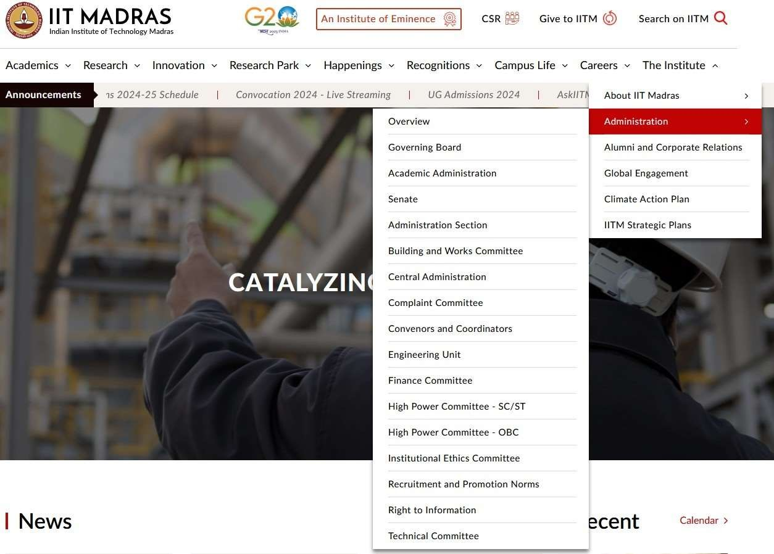

Slide 3


Slide 4
CCASH - Objective
To enquire and recommend action against any kind of sexual harassment against women on campus
To create awareness among campus community about prevention and
prohibition of sexual harassment.
IIT Madras has ZERO Tolerance for Harassment
Sexual Harassment of Women at Workplace (Prevention, Prohibition and Redressal) Act, 2013, Govt of India

Slide 5
CCASH - Members
Prof. Deepa Venkitesh, Dept. of Electrical Engineering -- Chair
Smt. Chitrapavai G, Joint Registrar, Academic Research -- Co-Chair
Smt. Bharathi R, Assistant Registrar, Admin – Member Secretary
Prof. Sathyanarayana N Gummadi, Dean Students – Member
Prof. Rupesh Nasre, Department of Computer Science –Member
Dr. Lata Ramasheshan, External Expert – Invited Member
Dr. Kannegi Packianathan IAS, Former Chairperson, TNSCW, - Member
Dr. Srividhya, Clinical Head - Myndwell – Invited Member
Student Representatives:
  The Students’ General Secretary/ Research Affairs Secretary/ Hostel Affairs Secretary
Other Invitees based on the complaint – CSO,CMO.

Slide 6
Workplace Sexual Harassment - Definition
“Every woman visiting the campus has the right to a safe and secure workplace
environment irrespective of her age or employment/work status”
“Sexual Harassment” includes any or more of the following unwelcome acts or behavior whether directly or by implication faced by women in her workplace namely:-
Physical contact or advances;
A demand or request for sexual favours; or
Making sexually coloured remarks.
Showing pornography; or
Any other unwelcome physical, verbal or non-verbal conduct of sexual nature;
Source : POSH Act 2013

Slide 7
Examples of behaviour that constitute sexual harassment at the workplace
Making sexually suggesting remarks or innuendos.
Serious or repeated offensive remarks, such as teasing related to a person’s body or appearance.
Offensive comments or jokes.
Inappropriate questions, suggestions or remarks about a person’s sex life.
Displaying sexist or other offensive pictures, posters, mms, sms, whatsapp, or e-mails.
Intimidation, threats, blackmail around sexual favours.
Threats, intimidation or retaliation against an employee who speaks up about unwelcome behaviour with sexual overtones.
Unwelcome social invitations, with sexual overtones commonly understood as flirting.
Unwelcome sexual advances which may or may not be accompanied by promises or threats, explicit or implicit.

Slide 8
Examples of behavior that constitute sexual harassment at the workplace
Physical contact such as touching or pinching.
Caressing, kissing or fondling someone against her will (could be considered assault).
Invasion of personal space (getting too close for no reason, brushing against or cornering someone).
Persistently asking someone out, despite being turned down.
Stalking an individual.
Abuse of authority or power to threaten a person’s job or undermine her performance against sexual favours.
Falsely accusing and undermining a person behind closed doors for sexual favours.
Controlling a person’s reputation by rumour-mongering about her private life.

Slide 9
CCASH – What is a Workplace?
Any place visited by the employee arising out of or during the course of employment.
A trip to a place as part of work.
Vehicle for transportation to and from work.
Parks, canteens, library, laboratory, any public place within the institute.
Conference place.
The definition of
institutions etc.
workplace
includes
Government
organizations,
educational

Slide 10
What to do if you happen to get harassed ?
Keep a record of all notes of sexual harassment, for example, call records, WhatsApp messages, photos/ videos, emails, Facebook posts, Instagram posts etc.
Send a written complaint to ccash@zmail.iitm.ac.in
Contact a member of CCASH over phone.
For more details, please visit the IIT Madras website below:
https://www.iitm.ac.in/the-institute/administration/complaint-committee
DO NOT feel embarrassed to complain.
Freedom from harassment at the workplace is a Fundamental Right.

Slide 11
Who can approach ICC/CCASH?
Aggrieved Women
Working (Employed
Directly or through Agent)
Visiting a workplace
Student
Regular/Temporary/Ad
Hoc/Daily Wager
Domestic Workers/ any other person visiting the campus
Student /
Scholars/Probationer/Trainee
/Apprentice/called by any
other such name.
Source: Taken from POSH Handbook

Slide 12
Who can make complaint?
Person who has experienced harassment – Complainant
A friend , relative, teacher, student/ legal heir of the complainant (if the complainant is not in a position to complain) after letting the complainant know that she is going to make a complaint, and with the consent of the complainant as the case may be.
Any other person who is witness to the harassment, after getting a written consent from the complainant
Complaint to be made within three months of the incident

Slide 13
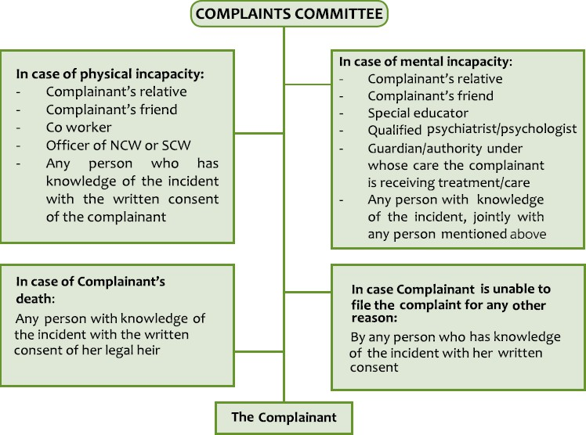
Who can make complaint? - Contd
Source: Taken from POSH Handbook

Slide 14


INCIDENCE OF WORKPLACE SEXUAL HARASSMENT TO BE REPORTED
WITHIN 3 MONTHS
INFORMAL
FORMAL
CONCILIATION
CCASH
The respondent fulfils his obligations as agreed upon: the case is closed
The respondent fails to fulfil his obligations as agreed upon: a formal inquiry will commence
One copy of the complaint to be
forwarded to the respondent
 | COMPLAINT NOT UPHELD: INCONCLUSIVE recommend to employer that no action is required to be taken
 | COMPLAINT UPHELD: Recommendations to be implemented by the employer within 60 days on receipt of the report
Inquiry report to be completed within 90 days by the CCASH
If not satisfied by the recommendations or non-implementation of such recommendations, the complainant and the respondent can appeal as per section 18(1) and 18(2) of POSH Act
Report of the findings to be submitted to the employer and concerned parties within 10 days of completion of the inquiry

Slide 15
The Sexual Harassment Complaint Process
Step 1: Receive and acknowledge the receipt of
the complaint.
Step 2: Complaint form is shared with the
complainant.
Step 3: Convene a pre-meeting and meet and
talk to the complainant and Explain the options
of conciliation and full-fledged enquiry.
Step 4: Provide an interim remedy/relief to the
complainant.
Step 5: Complaint is forwarded to the respondent.
Step 6: Conduct an enquiry with the
complainant and the respondent.
Step 7: Enquire the witnesses of the case if applicable.
Step 8: Examination of all the other evidences
and supporting documents.
Step 11: A copy of the findings to be shared to both the parties; complainant and respondent.
Step 9: Complete the enquiry within 90 days of
the receipt of the complaint.
Step 10: Submit the enquiry report to the
employer/competent authority with the findings and recommendations within 10 days from the date of completion of the enquiry.
Source: Taken from POSH Handbook

Slide 16
CCASH Responsibilities
Complaint should be made within three months of the last alleged incident to the CCASH.
A copy of the complaint should be forwarded to the respondent within 7 days of filing the complaint.
Complete the inquiry within 90 days.
Submit the Enquiry Report to the Executive Authority of the Institute.
Share the findings of the enquiry to both the complainant and the respondent.
Ensure confidentiality of the entire proceedings.

Slide 17
Interim Measures – Actions during pendency of enquiry
During the pendency of an inquiry, on a written request made by the aggrieved woman, the
ICC may recommend to the employer / competent authority to
Transfer the complainant or the respondent to any other workplace; or
Grant leave to the aggrieved woman up to a period of three months; or
Grant such other relief to the aggrieved woman as may be prescribed.
Source : Handbook on POSH

Slide 18
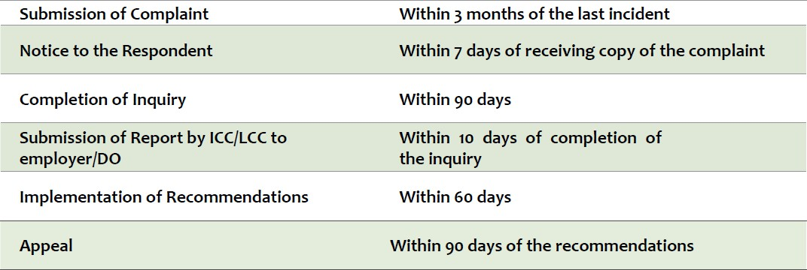
Timelines of the Act

Slide 19
Responsibilities of Executive Authority
Ensure that the workplace is safe for the complainant during the period of inquiry.
Act on the recommendations of CCASH within 60 days.

Slide 20
Inquiry Report – Recommendation of Punishment by CCASH
When the CCASH arrives at the conclusion that the allegation against the respondent has been proved, it shall recommend to the employer or the Disciplinary Authority, as the case may be-
To take action for sexual harassment as a misconduct in accordance with the provisions of the service rules applicable to the respondent or where no such service rules have been made, in such manner as may be prescribed.
Some of the examples of punishments for students include:
Debarring/Removal from Position of Responsibility (PoR)
Written Apology
Rustication from the Hostel or from the Institute
Dismissal from the Institute.

Slide 21
Inquiry Report – Recommendation of Punishment by CCASH
Some of the examples of punishments for employees include
Censure
Reduction to the lower scale of pay.
Removal/debarment from a position of responsibility.
Withholding of all types of NoC by the Institute for a certain period.
Dismissal from Service.
  To deduct, notwithstanding anything in the service rules applicable to the respondent, from the salary or wages of the respondent such sum as it may consider appropriate to be paid to the aggrieved woman or to her legal heirs, as it may determine, in accordance with the provisions of Section 15.

Slide 22
Punishment for false or malicious complaint and false evidence
If the ICC concludes that the allegations against the respondent is malicious or the
aggrieved woman or any other person making the complaint has produced any forged or misleading document, it may be recommended to the employer, as the
case may be, to take action against the complainant.

Slide 23
Responsibilities of Complainants
Make sure you have all your evidence.
  Be consistent.
  Do not blame yourself.
  Do not build up an issue just for effect.
If a sexual act was consensual do not make it a case of sexual harassment.

Slide 24
Responsibilities of Respondents
Do not threaten the complainant with dire consequences.
  This will lead to being expelled from the Institute.
Do not cover tracks.
  Eg : deletion of Whatsapp messages, deletion of SMSes, tampering with email servers, tampering with facebook, instagram, tampering with evidence of any kind.

Slide 25
Conciliation
Conciliation can be made at the instance of aggrieved complainant and not at the
instance of aggrieved respondent.
Conciliation is possible only at the threshold of an ICC inquiry, and not after a detailed enquiry has been conducted.

Slide 26
Appeal
Any person aggrieved from the recommendations made by the ICC may prefer an appeal to the court or tribunal in accordance with the provisions of the service rules applicable to the said person or where no such service rules exist then, without prejudice to provisions contained in any other law for the time being in force, the person aggrieved may prefer an appeal in such manner as may be prescribed as per Section 18(1) and Section 18(2) of the POSH act of 2013.
The appeal shall be preferred within a period of ninety days of the recommendations.

Slide 27
Let us strive to make IIT Madras a safe place with equal opportunity for all
IIT Madras has ZERO Tolerance for Harassment
Thank you!
ccash@zmail.iitm.ac.in 94985 99700 / 044 2257 8345
Sexual Harassment of Women at Workplace (Prevention, Prohibition and Redressal) Act, 2013, Govt of India

